Slide 1
HOST BEHAVIOR ANALYSIS
By Team 3-A

Slide 2
Introduction
Analysis on how host behavior varies across a variety of metrics.
Technology:
SQL
Excel

Slide 3

MEET OUR TEAM
Avinash Kumar
Syed Shoeb
Lokesh Pal Arya

Slide 6
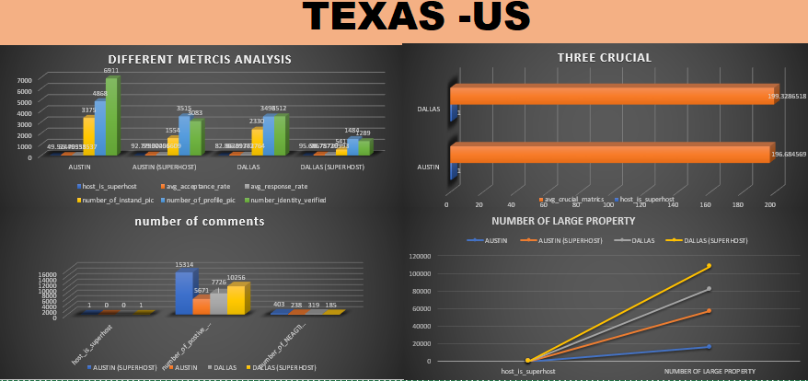

Slide 7
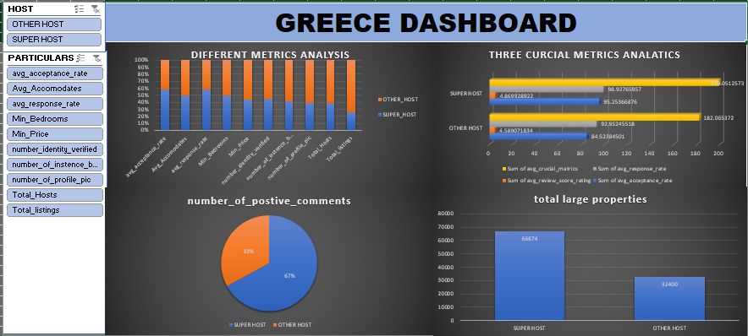

Slide 8
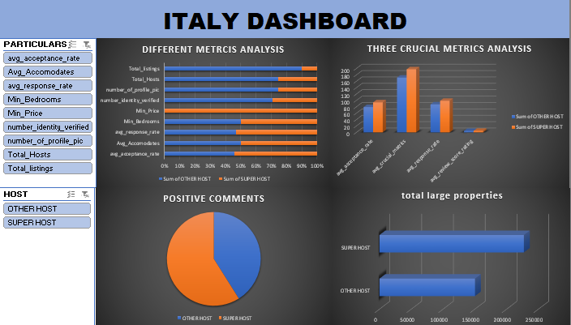

Slide 9
CHALLENGES
Importing data into ssms.
Understanding the data .
Cleaning the data such as Null values.
A little challenges faces while connecting with team-members.
LEARNINGS
How to work in a team.
Importing large data in ssms.
Research the tasks which were not known by us previously.
Grouping the mupltiple tasks which were assigned individually.

Slide 10
FUTURE SCOPE
The insights can be further referred to collect information about the given dataset.
One can get idea of how to analyse the host behaviour of a industry.
Understanding which area is well performed by a particular host.

Slide 11
THANK YOU!

